Slide 1
Analyzing Military Expenditure Between 1995 - 2005
DATS 6103 – Individual Project 1
David Robison

Slide 2
Presentation Overview
Background
Analysis of Military Expenditure
Summary of Findings

Slide 3
Motivations
Situation: Well conducted geopolitical relations require an understanding of a country’s history, political contexts, and key trends. Trends in military expenditure are an example of a important indicator that must be accounted for by geopolitical leaders during both peace and war times.
Action: Conduct an analysis of national military expenditure for the G20 nations over a ten year period.
Result: A rigorous assessment of military expenditure can provide insight into the country’s overall priorities and inform the development of foreign and domestic policies by geopolitical leaders.
Note: G20 nations include Argentina, Australia, Brazil, Canada, China, France, Germany, India, Indonesia, Italy, Japan, South Korea, Mexico, Russia, Saudi Arabia, South Africa, Turkey, United Kingdom, and United States

Slide 4
Analysis Overview
Data Sources:
Stockholm International Peace Research Institute (SIPRI) Military Expenditure Database: 1988 - 2015
World Bank National Accounts Data and OECD National Accounts Data Files.
Data Mining Goals:
Assess the military expenditure of G20 nations for a ten year period in Constant Dollar values.
Compare the military expenditure to the Real Gross Domestic Product (GDP) of G20 nations for a ten year period.
Identify nations with fastest growth in military expenditure over a ten year period.
Note: Constant Dollar value data adjusts for the effects of inflation by using a base year for the dollar amount, allowing for a comparison between years.

Slide 5
Findings on Military Expenditure Between 1995 - 2005

Slide 6
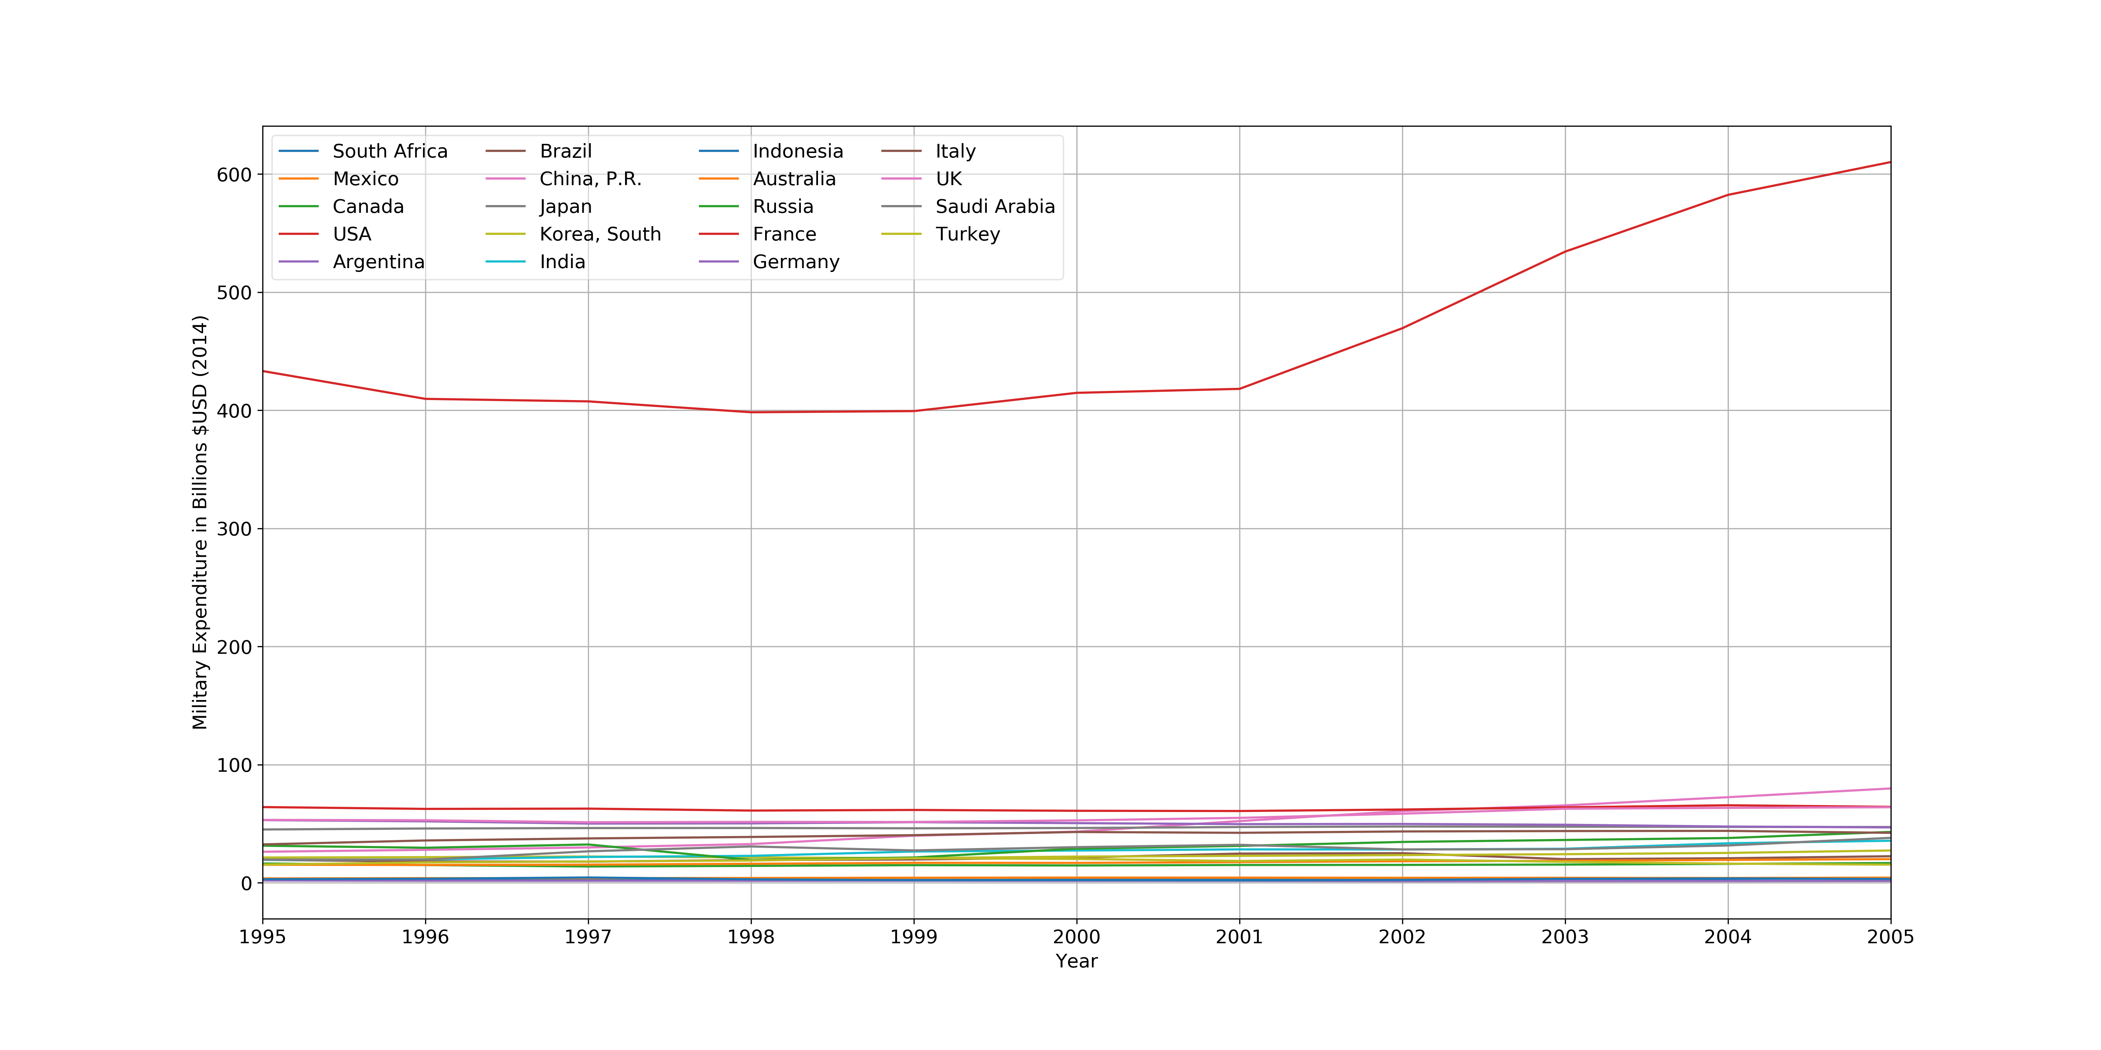
Annual Military Expenditure by G20 Nations: 1995 - 2005
Top 10 Countries
Country | Average Expenditure: ($USD Billion)
United States | 461.579456
France | 62.653123
United Kingdom | 56.023004
Germany | 49.989922
China | 48.199522
Japan | 46.595034
Italy | 40.293565
Russia | 31.409192
Saudi Arabia | 28.372464
India | 26.481224
Notes:
Immediately we can see the United States' military expenditure in 1995 was over 3 times more than the next closest country, although the expenditure was relatively constant between 1995 – 2001. However, starting in 2001, this discrepancy in military spending became much more exaggerated with the U.S. spending more than 6 times difference in MilEx by 2005 aligned with the the U.S. conducting a two front war in Afghanistan and subsequently Iraq.

Slide 7
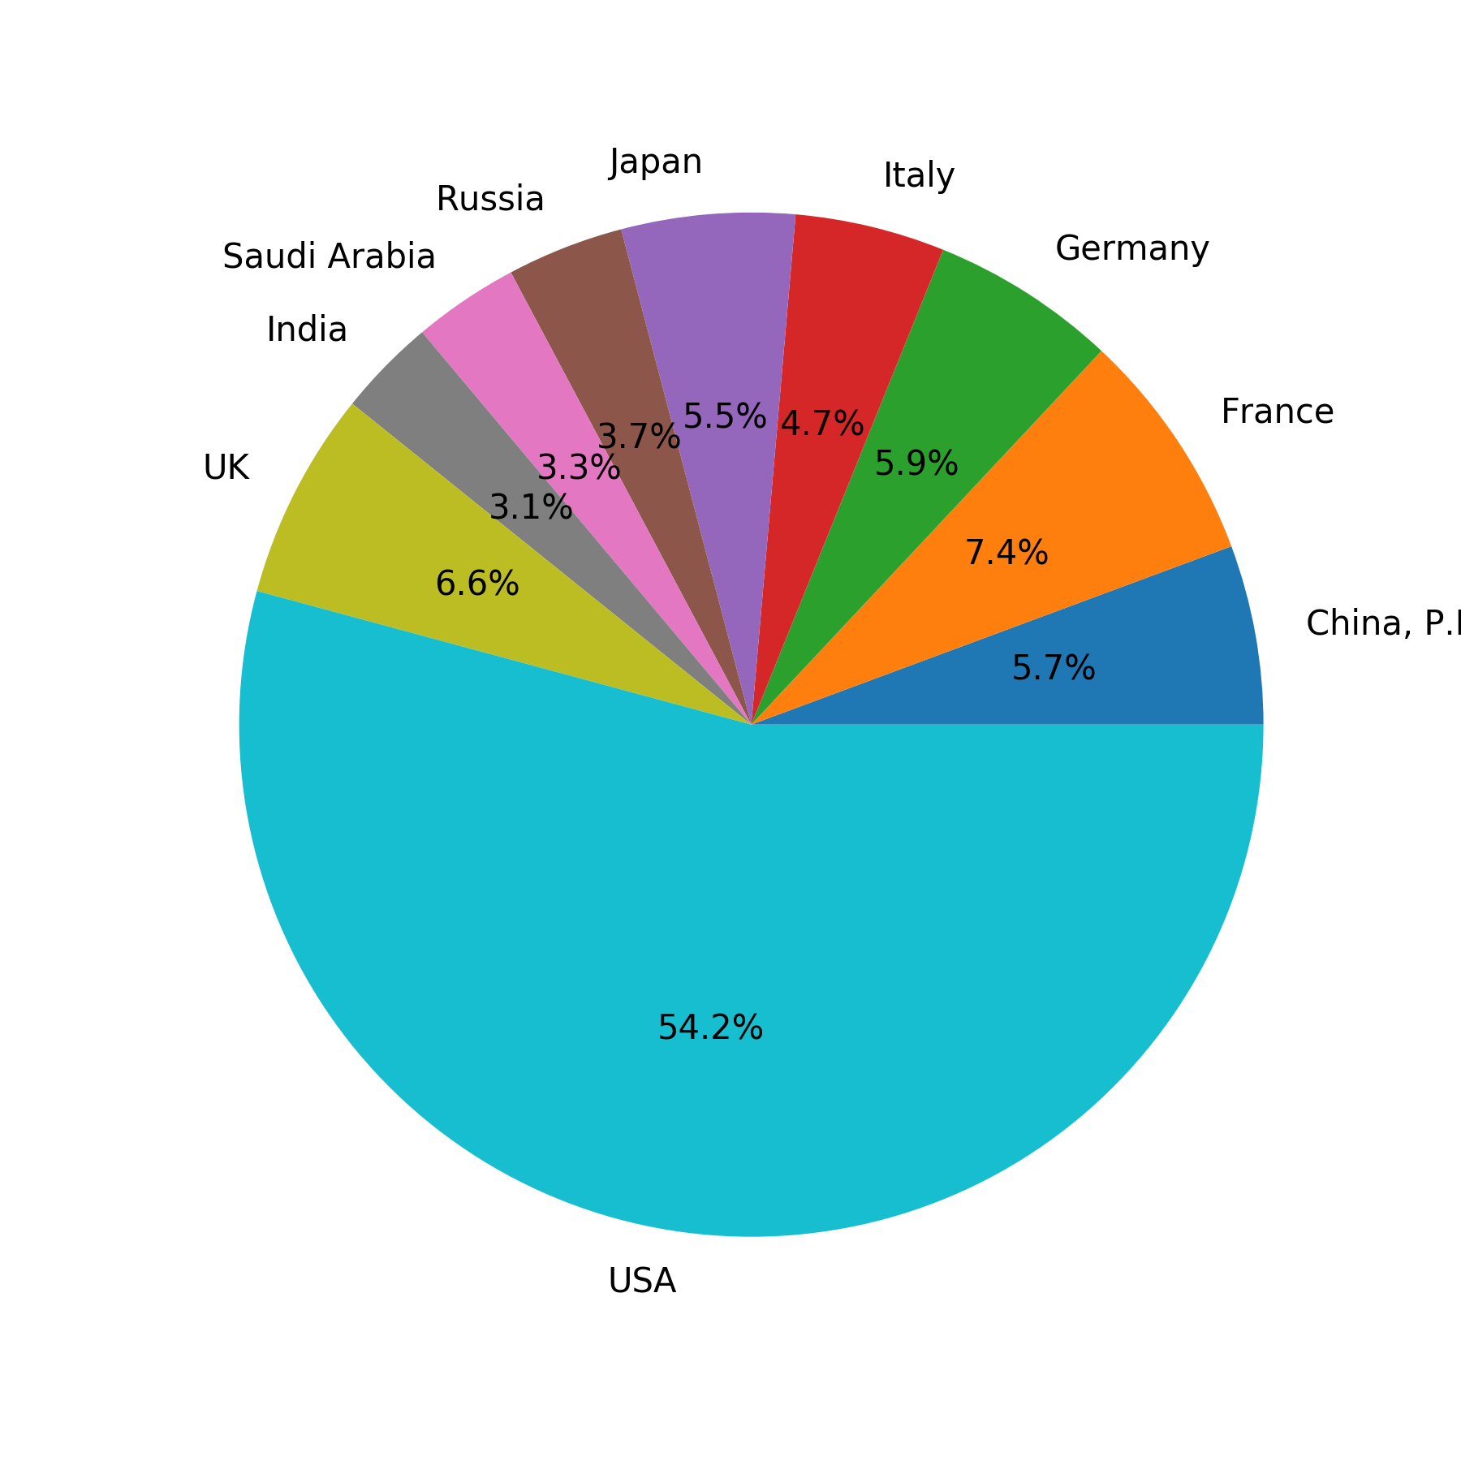
The Top 10 Countries in Cumulative Military Expenditure
Percent of Total Military Expenditure From1995 to 2005 By Each Nation
Top 10 Countries
Country | Cumulative Expenditure ($USD Billion)
United States | 5077.374012
France | 689.184354
United Kingdom | 616.253047
Germany | 549.889143
China | 530.194737
Japan | 512.545373
Italy | 443.229216
Russia | 345.501112
Saudi Arabia | 312.097108
India | 291.293459
Notes:
The US’ spent more than the next 9 countries combined between 1995 – 2005 this finding is absolutely stunning.

Slide 8
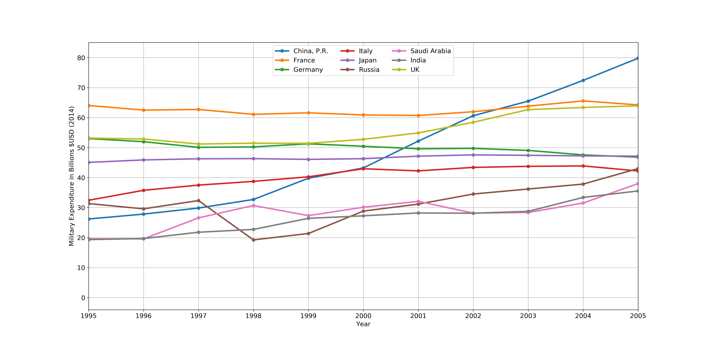
Excluding the United States, China Shows a Large Increase in Military Expenditure Over This Time
Notes:
'''This immediately shows us some interesting data. First in 1995, outside of the U.S., France had the highest MilEx, at over $60B, and approximately 10 billion more than European counterparts Germany and the United Kingdom. However after2001 where we saw a huge spike for the U.S. we see a similar spike for the UK, but not for France or Germany. Additionally, by 2005 China's military expenditure had significantly increased from amongst the lowest~25B to the highest of all non-US nations ~$80B with steep increases beginning in 1998 despite the Asian Financial zCrises'''

Slide 9
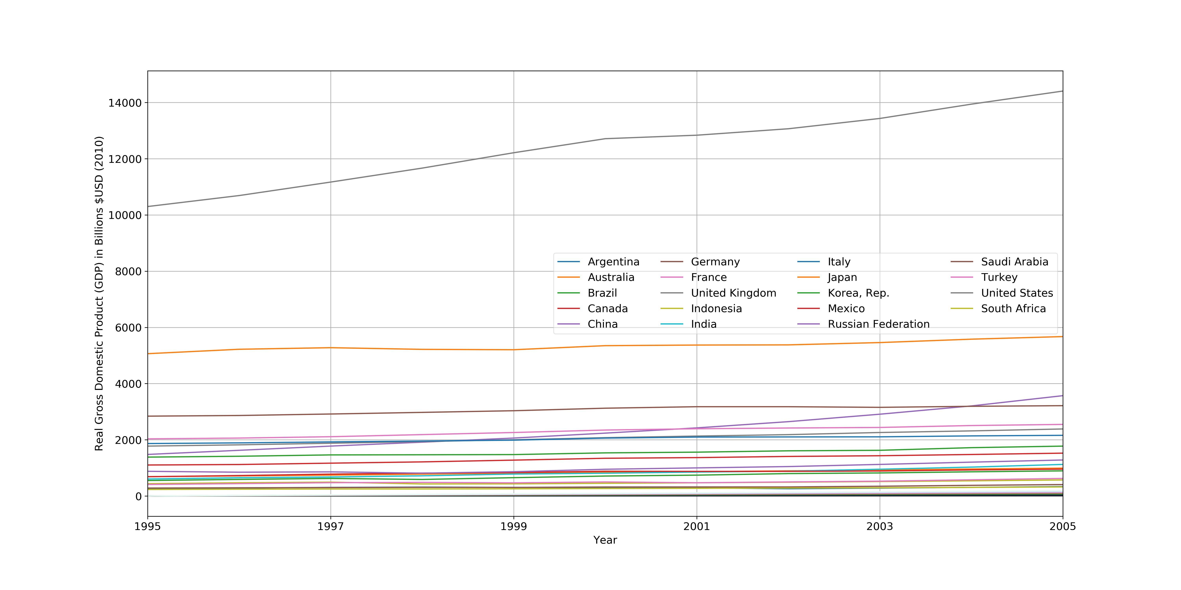
Real Gross Domestic Product (GDP) of G20 Nations
Top 10 Countries
Country | Average Annual Real GDP: ($USD Billion)
United States | 12403.467063
Japan | 5344.625950
Germany | 3060.935961
China | 2349.868185
France | 2299.984106
United Kingdom | 2069.552514
Italy | 2026.020289
Brazil | 1547.651720
Canada | 1312.142955
Russia | 988.206797
Notes:
Japan _ Orange: Second highest average GDP but not same relative position in average milEx
Saudi Arabia and India: Not among 10 highest average annual real gdp, but among the top 10 in average mil expenditure
Canada: Among Highest GDP but not in top 10 of milex
USA 461.579456 France 62.653123 UK 56.023004 Germany 49.989922 China, P.R. 48.199522 Japan 46.595034
Italy 40.293565 USSR/Russia 31.409192 Saudi Arabia 28.372464 India 26.481224 Korea, South 22.936879
Brazil 20.734425 Turkey 17.937124 Australia 17.146545 Canada 15.163360 Mexico 4.072226 South Africa 2.992893
Indonesia 2.977444 Argentina 1.599343

Slide 10
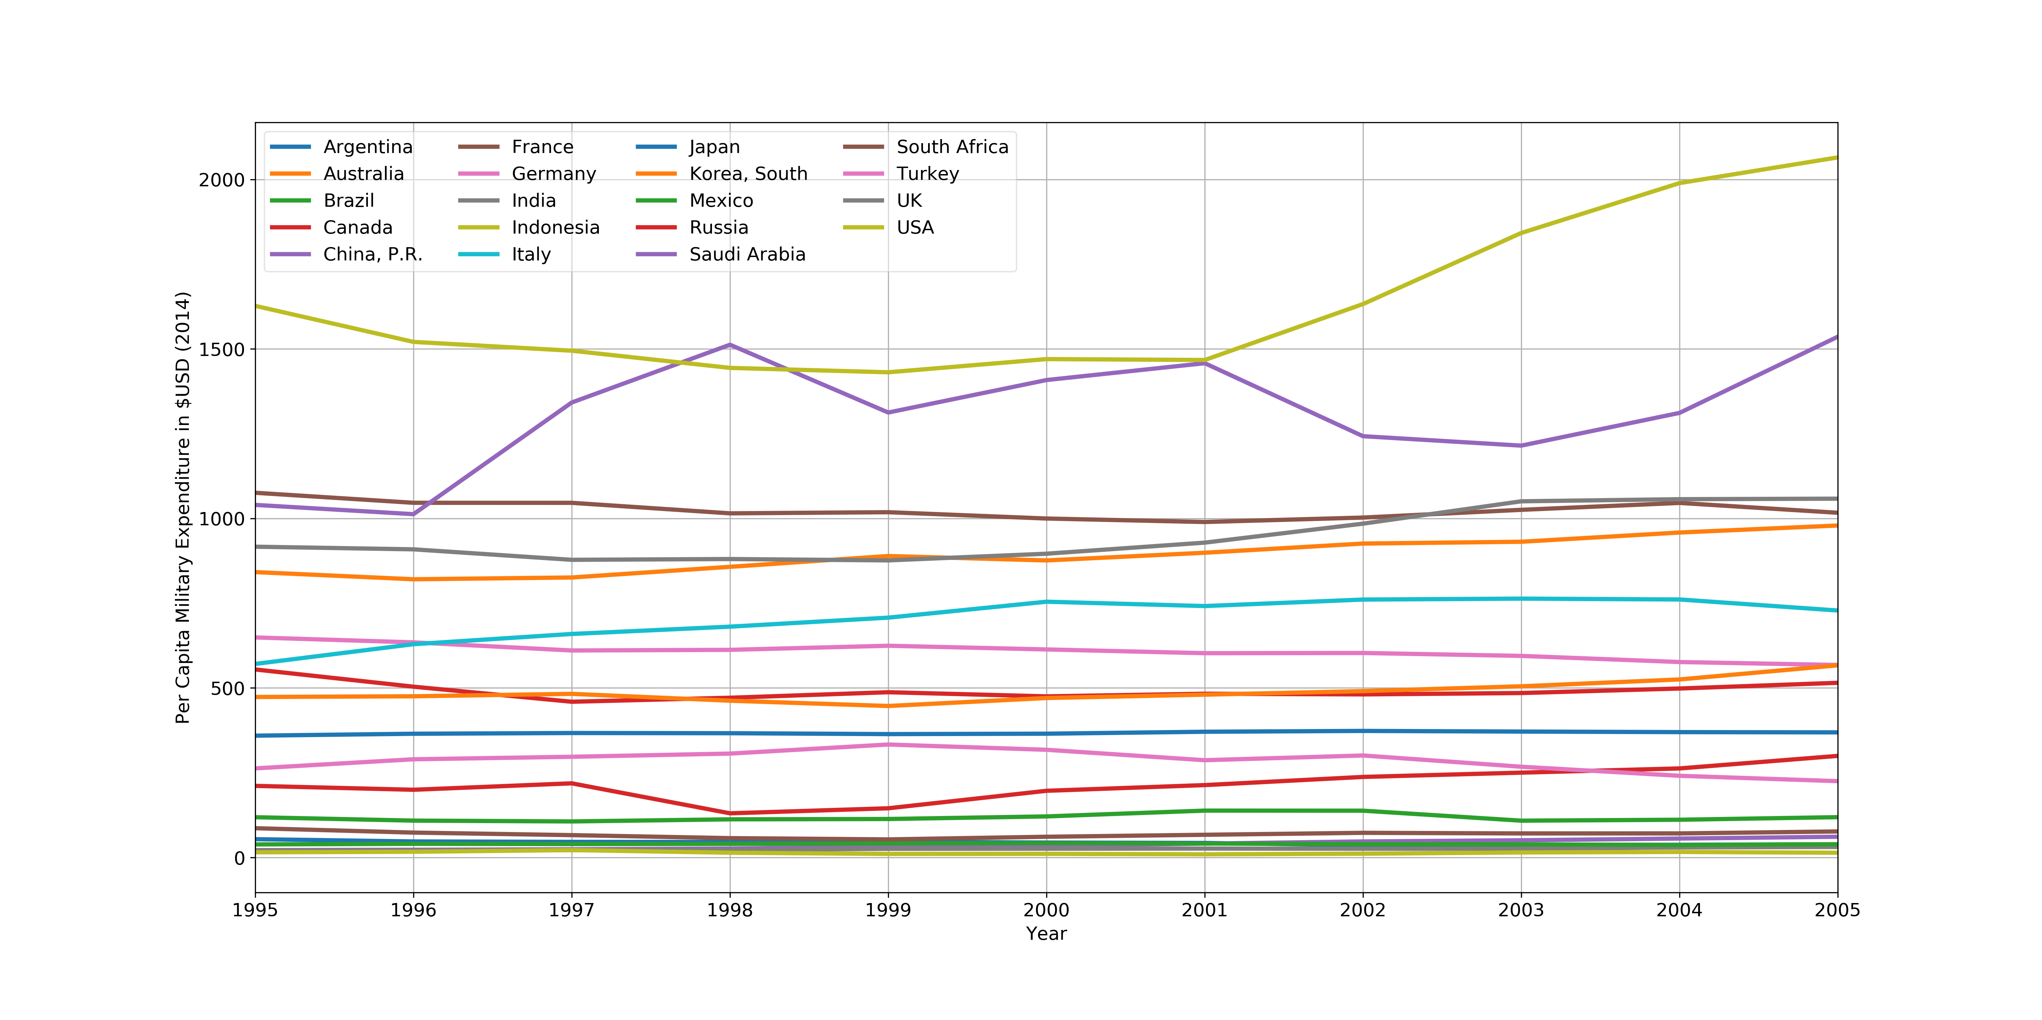
Annual Per Capita Military Expenditure of G20 Nations
Top 10 Countries
Country | Average Per Capita Expenditure: $USD
United States | 1634.78
Saudi Arabia | 1308.15
France | 1025.53
United Kingdom | 948.62
Australia | 891.30
Italy | 705.19
Germany | 608.12
Canada | 492.20
South Korea | 488.99
Japan | 367.40
Notes:
We see a nicer range of per capita military expenditure for G20 nations. For this time period, Indonesia had the lowest average at $14 and the U.S. the highest at $1634.78. Saudi Arabia was among the leaders in military expenditure and this is reflected in their per capita military expenditure and we see their increase more closely here starting in 2001.

Slide 11
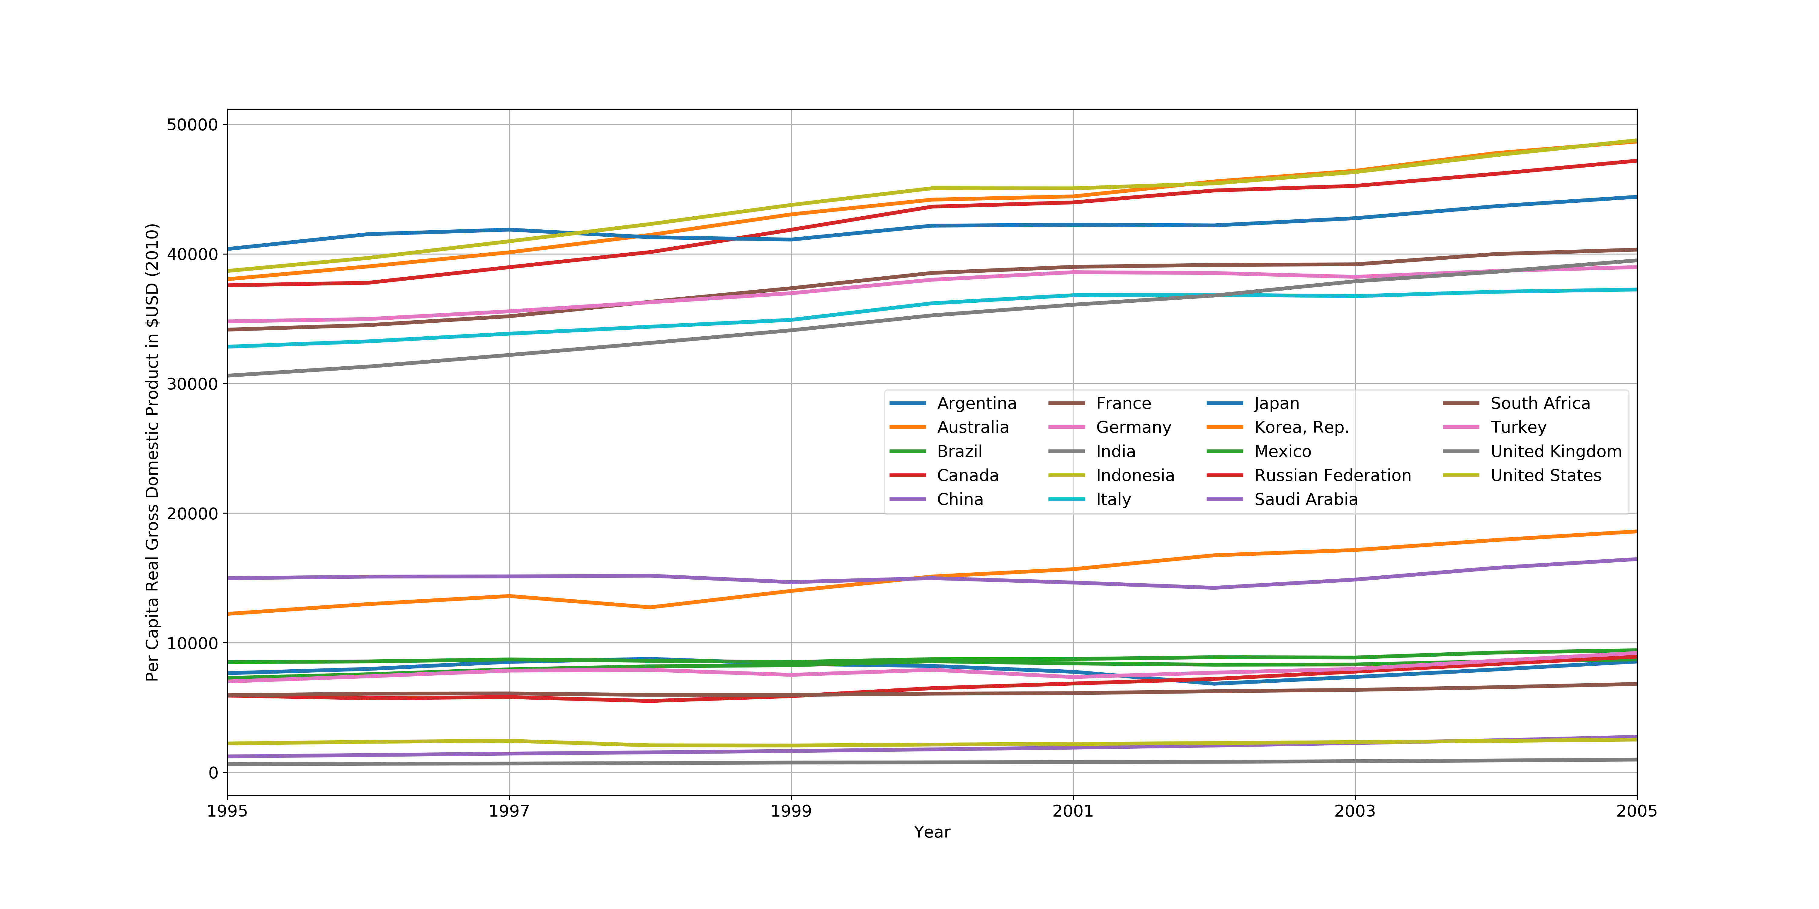
Annual Per Capita Real Gross Domestic Product of G20 Nations
Top 10 Countries
Country | Average Per Capita Real GDP: $USD
United States | 43962.98
Australia | 43517.16
Canada | 42486.67
Japan | 42139.03
France | 37601.31
Germany | 37227.04
Italy | 35460.40
United Kingdom | 35036.68
South Korea | 15154.58
Saudi Arabia | 15087.86
Notes:
The US’ per capita real GDP is in line with many other nations however our annual per capita military expenditure and total annual military expenditure far exceeds other G20 nations.

Slide 12
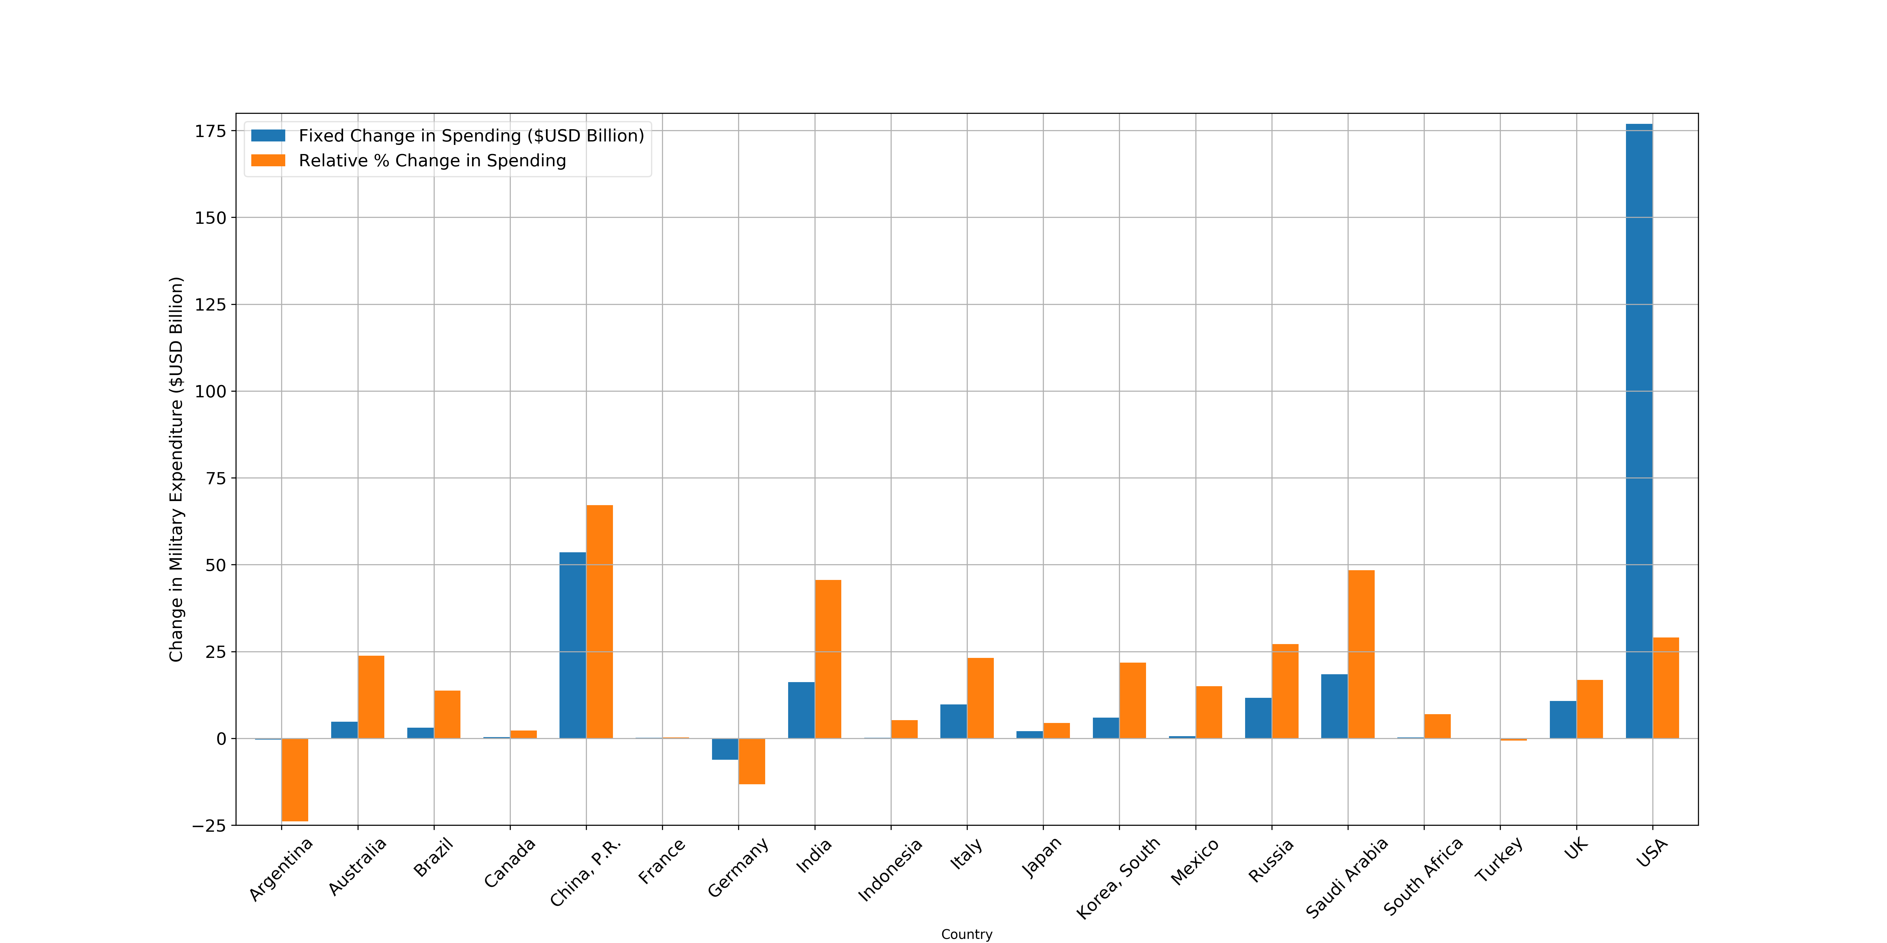
Changes in Military Expenditure Between 1995 - 2005
Top 10 Countries
Country | Relative Change in Military Spending
China | 67.15%
Saudi Arabia | 48.42%
India | 45.61%
United States | 29.00%
Russia | 27.13%
Australia | 23.82%
Italy | 23.15%
Korea, South | 21.76%
United Kingdom | 16.80%
Mexico | 15.02%

Slide 13
Summary of Findings

Slide 14
From 1995 to 2005 Multiple G20 Nations Increased Their Military Expenditure By More Than 20 Percent
The United States’ annual military expenditure is 6 times greater than the next closest nation, and accounted for over 50 percent of the cumulative military expenditure during this time period.
Along with India and Saudi Arabia, China had the fastest growth in military expenditure ( > 65% ) during this period to become second behind the U.S. in annual military expenditure.
For nations such as Japan, Saudi Arabia, India, and Canada military expenditure does not necessarily align with Gross Domestic Product (GDP). Saudi Arabia and India are among the highest in military expenditure, but not the highest in GDP.
Notes:
Japan _ Orange: Second highest average GDP but not same relative position in average milEx
Saudi Arabia and India: Not among 10 highest average annual real gdp, but among the top 10 in average mil expenditure
Canada: Among Highest GDP but not in top 10 of milex

Slide 15
References
Stockholm International Peace Research Institute. SIPRI Military Expenditure Database. Available at: https://www.sipri.org/databases/milex. Accessed March 14, 2017.
The World Bank. World Development Indicators GDP at market prices (constant 2010 US$). Available at: http://data.worldbank.org/indicator/NY.GDP.MKTP.KD. Accessed March 14, 2017.
Max Roser and Mohamed Nagdy – ‘Military Spending’. Available at: https://ourworldindata.org/military-spending/. Accessed March 14, 2017.
The World Bank. What is the difference between current and constant data? Available at: https://datahelpdesk.worldbank.org/knowledgebase/articles/114942-what-is-the-difference-between-current-and-constan. Accessed March 15, 2017.
The World Bank. World Development Indicators Population, total. Available at: http://data.worldbank.org/indicator/SP.POP.TOTL. Accessed March 14, 2017.
The World Bank. World Development Indicators GDP per capita (constant 2010 US$). Available at: http://data.worldbank.org/indicator/NY.GDP.PCAP.KD. Accessed March 14, 2017.

